Slide 1
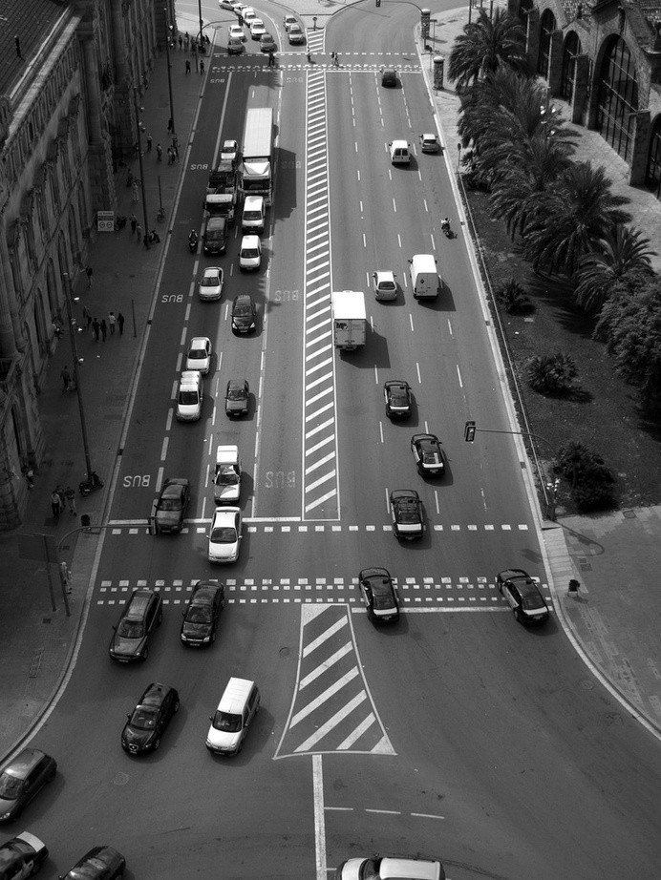
Presented by:- Samarth Jain
GPS Toll based System Simulation using Python

Slide 2
Problem statement
Transportation has emerged as a dominant part of India. Toll plazas play a crucial role in maintaining the road transportation. The existing toll plaza systems have a major problem of over charging drivers even if they don't travel the entire toll distance. So in order to overcome this problem our project will collect toll tax for the precise distance traveled by a vehicle over a highway stretch.

Slide 3
Objectives
1
2
3
4
5
Location
To introduce location constraint in toll tax
collection system . Collect tax only for the distance travelled
Hassle free experience
toSince the tax collection occurs
automatically when toll road starts and stops while exiting the road.
Reduce traffic
to eliminate long queue in toll gated by
automatic tax collection using location
Automatic toll fee collection
On getting the details of distance travelled
the calculated amount will be automatically debited from users account
.
Pay only for Distance Travelled
Since location constraint is available .we
can calculate accurate tax for distance traveeled in a toll road.

Slide 4
Key Features :
Based on RFID tag:
A vehicle passes a toll booth with an RFID tag. Detection, decoding and deduction occur, then the gate opens. Non-daily drivers must use a manual lane, reducing the need for a high-memory tag.
Based on Computer Vision:
Detection of vehicles by using the Open CV library on an embedded Linux architecture.
Based on GPS(Mobile Application):
An app that reads GPS and timestamps info to check journey/gantry data and calculate tolls, creating a charge and alerting user if on a toll road.
Based on NFC(Near Field Communication)
It is a tag that contains details of the vehicle and once it crosses the toll gate, the tag is scanned and the toll collection is started.

Slide 5
Process Flow
With the existing GPS technology in Automobiles, we use a Raspberry Pi unit to track the start and end points of the car.
This start and end points data are sent to the AWS cloud. With the use of AWS' own IOT services, we can connect the Raspberry Unit to the Cloud. The data can be stored and processed over the cloud.
The cloud receives a trigger when the end point is received where the payable amount is calculated and deducted from the user.
The part where the user has to pay extra for untraveled distance and vehicle stoppage are avoided.

Slide 6

Block Diagram
Vehicle Enters Highway
GPS Module Activates
Startpoint initialise to zero
Endpoint is intiated
Vehicle exits Highway
Distance is calculated using endpoint
Endpoint is Transmitted to cloud server
Payment Initiated
Toll Tax Calculation
Payment Gateway
if transaction is success
Notification trigerred

Slide 7
Solution
The large traffic jams near the toll plazas which cause a wastage of time and fuel can be reduced by installing a toll collection system that uses GPS tracking.
·This system enables the toll-road users to pay the toll fees without stopping or slowing down.
·This proposed system automatically identifies the vehicle that advance towards the toll plazas and observes the vehicle number and the time of arrival. By comparing the position of the vehicle and toll plaza, the owner of the vehicle can be charged from the account
c

Slide 8
Used Technology
GPS Module:
It contains tiny processors and antennas that directly receive data sent by satellites through dedicated RF frequencies. From there, it'll receive timestamp from each visible satellites, along with other pieces of data.
AWS IOT Core:
AWS IoT Core is a managed cloud service that enables connected devices to securely interact with cloud applications and other devices. AWS IoT Core can support many devices and messages, and it can process and route those messages to AWS IoT endpoints and other devices.
Payment Service:
A payment gateway is a merchant service provided by an e-commerce application service provider that authorizes credit card or direct payments processing

Slide 9

Conclusion
In conclusion, the GPS-based dynamic toll tax collection system is a project that serves the community in many ways.
This system offers a more efficient and effective way of collecting toll taxes, reducing traffic congestion, and improving the overall transportation experience.
Additionally, we have integrated AWS IoT services using the MQTT protocol.
The distance traveled and tax amount calculation have been carried out within the AWS cloud environment. We have also developed Lambda functions to link various other processes.
Payment integration has been implemented through Flask
Overall, the GPS-based dynamic toll tax collection system is an excellent example of how engineering can contribute to community service and make a positive impact on people's lives.

Slide 10


ThankYou

